Slide 1

Bowland High
Year 7 Keywords Booklet

Slide 2
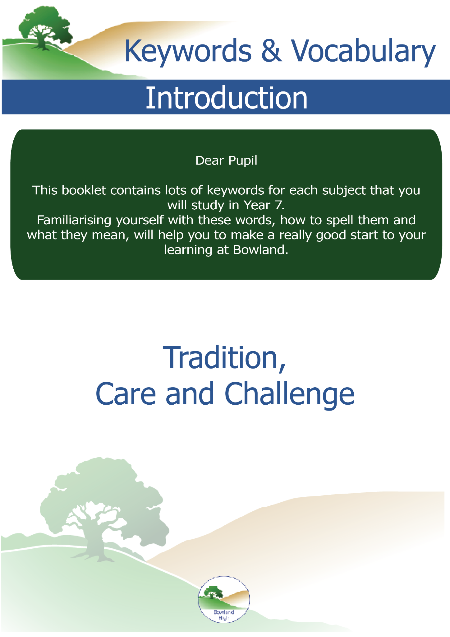

Slide 3

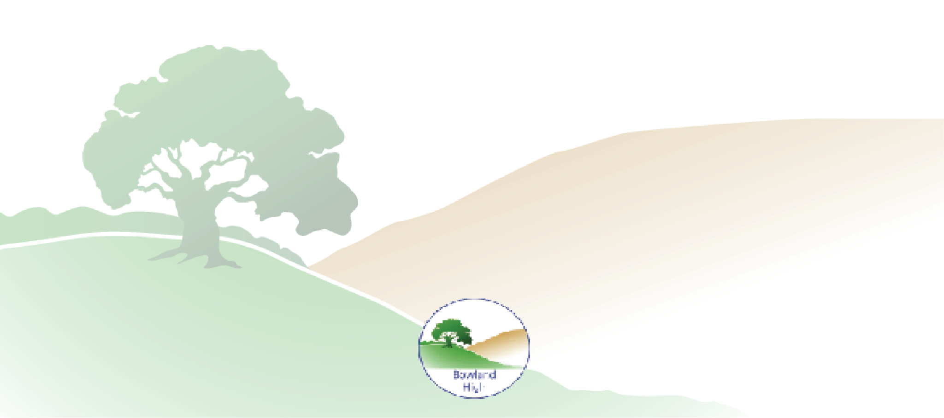
Year 6 to 7 Transition: Art
Colour
The property given out by an object that is picked up by the back of the eye as a result of the way it emits or reflects light
Primary
Any group of colours from which all the other colours can be obtained by mixing
Secondary
A colour resulting from the mixing of two primary colours
Tertiary
A colour produced by an equal mixture of a primary colour with a secondary colour
Perspective
How an artist makes things appear close or far away
Sketch
A rough unfinished drawing or painting, often made to assist in the making of a more finished picture
Proportion
A part of a whole, or the relationship between two things in terms of their size
Scale
The overall physical size of an artwork or objects in it

Slide 4
Year 6 to 7 Transition: Computing
Hardware
Parts of a computer or device that you can see and touch
Software
Programmes and applications that run on a computer or device
Sensor
A device which records data about the physical environment such as heat, movement or light
Processor
The brain of the computer
Storage
Devices that store your files such as videos, photos or documents
Online Safety
Methods of staying safe when using the internet and apps
Algorithms
A set of instructions that are easy to understand
Binary Numbers
Numbers that computers understand made up of 1s and 0s
Graphics Software
A computer programme that can be used to create or edit images
Subroutine
A set of instructions to carry out a specific task

Slide 5
Year 6 to 7 Transition: Design Technology
Design
A drawing or set of drawings showing how something will be made
Brief
A set of instructions given about a job or task
Analysis
A detailed examination of the elements or structure of something
Prototype
A preliminary version of something from which other forms are developed
Dimension
A numerical value that specifies the size, shape, location, or orientation of a feature
Aesthetic
An opinion towards a product with regards to their shape, colour, size, content etc
Specification
A detailed description of the design and materials used to make something
Materials
The matter from which a thing is or can be made
Manufacturing
The making of articles on a large scale using machinery
Sustainable
The ability to be maintained at a certain rate or level

Slide 6
Year 6 to 7 Transition: English
Antagonist
A character in a story who is presented as the chief foe of the protagonist
Character
A person in a novel, play, or film
Structure
The building blocks used to construct a written text
Narrative
A story; spoken or written account of connected events
Language
Words used in a structured way by speech or writing.
Foil
A character who contrasts with another character; typically, a character who contrasts with the protagonist
Hero
A real person or fictional character who, in the face of danger, combats adversity through feats of ingenuity, courage or strength
Protagonist
The leading character or one of the major characters in a play, film or novel etc
Villain
A character whose evil actions or motives are important to the plot

Slide 7
Year 6 to 7 Transition: Food Technology
Diet
The kinds if food that a person eats
Nutrition
The process of obtaining the food necessary for health and growth
Hygiene
Conditions necessary to maintain health, especially through cleanliness
Safety
The condition of being protected from danger, risk or injury
Hazard
A danger or risk
Food poisoning
Illness caused by bacteria or other toxins in food
Bacteria
Micro-organisms that can cause infection and disease in humans
Fruit
The sweet and fleshy product of a tree or plant that can be eaten as food
Vegetable
A plant or part of a plant
Knife / Knives
An instrument with a blade and a handle, used for cutting
Saucepan
A deep cooking pan with a long handle and a lid

Slide 8
Year 6 to 7 Transition: Geography
Physical Geography
Deals with the processes and patterns in the natural environment
Human Geography
The study of societies, cultures and economies
Urban
Relating to a town or city
Rural
Relating to the countryside
County
A territorial division of a country eg Lancashire
Country
A nation with its own government eg England
Continent
A continuous expanse of land which is a collective area eg Europe
Cause
The reason why something has happened
Effect
The result of something that has happened
Response
A reaction to something
Social effect
Affects people
Economic effect
Affects money
Environmental effect
Affects the trees and plants around us

Slide 9
Year 6 to 7 Transition: History
Cause
The reason why something has happened
Consequence
The result of something that has happened
Monarch
Head of state, usually a king, queen or emperor
Chronology
The order in which events happened
Utility
How useful a source is for your understanding
Primary Source
A piece of evidence from the past, created at the time of the event
Secondary source
A piece of evidence created after the time of the event
Infer
What can you understand from the source?
Explain
Say why or how something happened
Describe
Say what happened in detail
Interpretation
A way of understanding an event or a series of events

Slide 10
Year 6 to 7 Transition: Maths
Prime
A number that has exactly two factors (1 and itself)
Factor
Divides exactly into a given number with no remainder
Multiple
What we get after multiplying by a whole number
Square Number
Produced when you multiply a number by itself
Integer
A whole number
Negative
A number less than zero
Estimate
To roughly calculate the value, number or quantity by rounding to one significant figure
Evaluate
To work out a numerical value
Factorise
To put into brackets by taking out the highest common factors
Expand
Multiply to remove the brackets

Slide 11
Year 6 to 7 Transition: Music
Performing
Presenting to an audience
Listening
To give your attention to a sound or sounds
Unison
To perform ‘as one’
Instrument
A device created or adapted to make musical sounds
Polyphonic
Involving many sounds or voices
Monophonic
Having only a single melodic line
Homophonic
Part(s) using the same rhythm as the melody
Solo
A piece for a single musician
Ensemble
A group who perform together
Composing
The act of creating musical works
Voice
The sound produced in the larynx and uttered through the mouth
Timbre
The character or quality of a musical sound or voice

Slide 12
Year 6 to 7 Transition: Performing Arts
Creating
The process of making
Characterisation
The creation of a character
Evaluating
Reflecting on your own work to identify strengths and weaknesses
Interaction
Reciprocal action with another person
Improvisation
Created ‘on the spot’, without preparation.
Performing
Presenting to an audience
Physical
Relating to your body
Projection
Communicating powerfully and clearly
Vocal
Relating to your voice
Genre
The category of a piece which will influence themes and characters

Slide 13
Year 6 to 7 Transition: Physical Education
Agility
Changing direction at speed
Coordination
Moving two or more body parts at the same time
Fitness
Coping with physical activities (without getting too tired)
Resilience
Taking on challenges and learning how to deal with failure
Skill
A learned movement
Strength
Applying force against a load
Tactics
Thinking / planning how to win or improve
Technique
How to perform a skill
Cardiovascular endurance / Stamina
Exercise for long periods of time without tiring

Slide 14
Year 6 to 7 Transition: PSHCE
Transition
A process of change
Resilience
The ability to ‘bounce back’ or become happy / successful again after difficulties or setbacks
Communication
Expressing your thoughts or feelings through the use of voice, body language, or written down
Health
The condition of the body and mind: the degree to which it is free from illness, or the state of being well
Mindfulness
The practice of being aware of your body, mind, and feelings in the present moment, thought to create a feeling of calm
Aspiration
The hope or ambition to achieve something
Stereotype
A set idea that people have about what someone or something is like, especially an idea that is wrong
Prejudice
An unfair and unreasonable opinion or feeling, especially when formed without enough thought or knowledge
Bullying
The behaviour of a person who hurts or frightens someone, often forcing that person to do something they do not want to do. Can be online or in person
Law
A rule, usually made by a government, that is used to order the way in which a society behaves
Democracy
A system in which everyone has equal rights and opportunities, and can help make decisions

Slide 15
Year 6 to 7 Transition: Religious Education
Atheism
A lack of belief in the existence of a god or gods
Agnosticism
Not knowing whether any gods exist
Belief
An acceptance that something is true
Buddhism
The major world religion followed by Buddhists
Christianity
The major world religion followed by Christians
Hinduism
The major world religion followed by Hindus
Islam
The major world followed by Muslims
Judaism
The major world religion followed by Jews
Sikhism
The major world religion followed by Sikhs
Monotheism
The belief that there is only one god
Polytheism
The belief in more than one god

Slide 16
Year 6 to 7 Transition: Science
Atom
Smallest particle that can exist on its own – all substances are made of these
Boiling point
Temperature at which a substance changes from a liquid to a gas
Condense
Change from a gas to a liquid
Dissolve
When a solid completely mixes with a liquid
Evaporate
Change from liquid to gas
Fair test
Change one variable, measure one variable and keep the rest the same
Gas
Particles in this state of matter are far apart
Liquid
Particles in this state of matter are very close but are free to move
Melting point
Temperature at which a substance changes from a solid to a liquid
Mixture
More than one substance - can be separated
Solid
Particles in this state of matter are very close together and in a fixed position
Temperature
How hot something is: measured in degrees Celsius (C)

Slide 17
Year 6 to 7 Transition: Spanish
Verb
An action or occurrence
Noun
A place, person, thing or idea (etc)
Adjective
A word that describes a noun or a group of nouns
Adjectival agreement
To make sure an adjective is in the same form as the thing it is describing
Clause
A group of words that includes a subject and a verb
Connective
Connects words and phrases
Personal pronoun
A word which replaces a noun to avoid repetition. Used in verb tables
Verb table
A table to show how different forms of a verb work with different tenses and structures
Verb ending
A set of letters attached to a verb stem to identify who is performing an action

